Slide 1
Does the church have a political message?
Margins 2016 Workshop

Slide 2
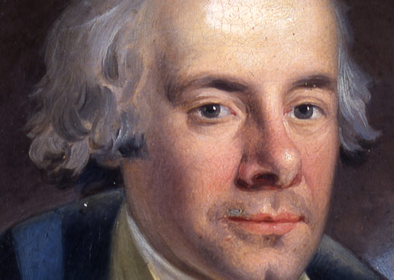
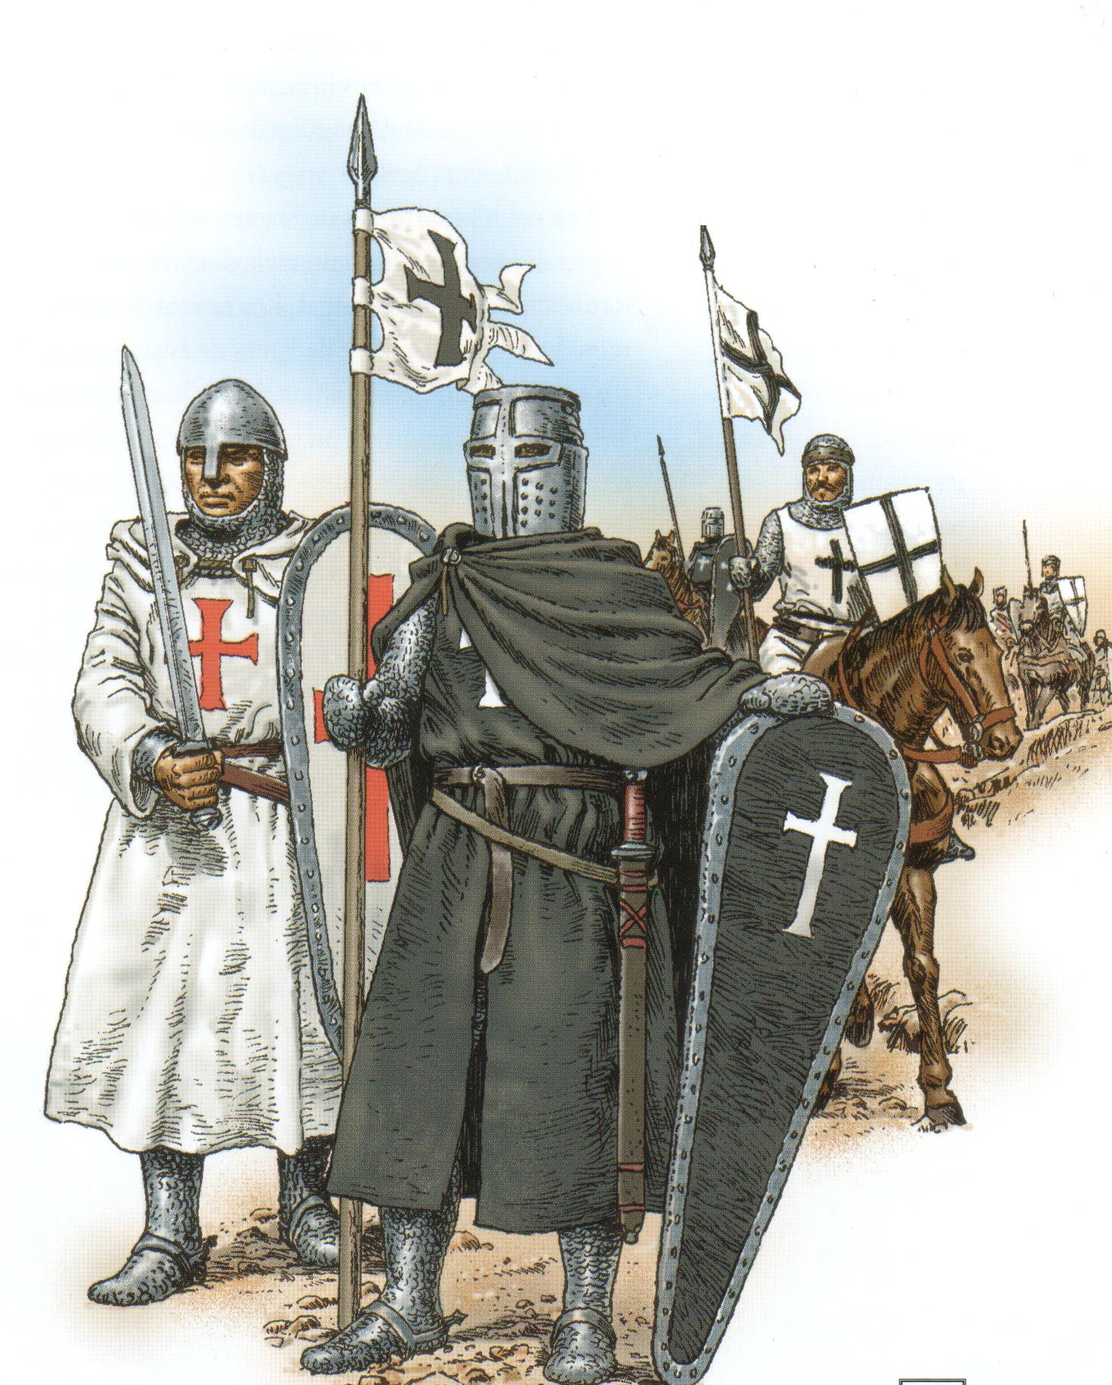

Slide 3
Definitions for this workshop
Church:
Politics:
A public and visible community, whose position is known :
Through its leaders.
Through its members via social media posts
Activities which may influence the actions and policies of a government or obtaining and maintaining power in a government
Someone’s opinions about what should be done by governments : a person's political thoughts and opinions

Slide 4
Church over State
Lobbying
Theocracy
State over Church
Retreat
Subjection

Slide 5
Church over State
Lobbying
Theocracy
Witness
State over Church
Retreat
Subjection

Slide 6
Message
Example
Witness
Gospel-oriented & redemptive
Not moralistic and social
The church shows its morals
The church manifests good works

Slide 7
10 reasons against lobbying
There is no NT mandate for political influence
There are no NT examples for political influence
There is a continuum from lobbying to theocracy
Christianity is impossible without the Holy Spirit
Morality does not save
Lobbying antagonizes those who need the Gospel
It leaves a painful legacy in church history
It’s impossible to balance biblical values
We are aliens and visitors
Difficult to honor those you oppose

Slide 8
Questions for debate ☺
Is the presence of US flag in a ‘church’ building political? Is it OK?
Should a Christian stewardess serve alcohol on a flight despite her convictions against it?
Should a city clerk refuse to sign same sex marriage licences?

Slide 9
Should the state forbid working on Sundays except for medical and emergency services ?
Someone wants you (as a pastor) to make your position clear on gun control – what do you say ?
What should the church do about prostitution and sex trade?
How should the church react to laws authorizing euthanasia?

